Slide 1



CANARA ENGINEERING COLLEGE, MANGALORE
Dept. of Computer Science & Business System
Mini Project Presentation
PROJECT GUIDE: ASHWINI K.G
21CBMP67
TEAM MEMBERS:
4CB21CB019-Himanshu
4CB21CB050-Sathwik
4CB21CB052-Shravya.R
4CB21CB060-Varun shetty

Slide 2


What is Phishing?
Phishing is a cybercrime that involves tricking individuals into providing sensitive information, such as usernames, passwords, and credit card details, by masquerading as a trustworthy entity in electronic communications.
Common Tactics:
Emails and Messages: Fraudulent emails or messages that appear to be from legitimate sources (banks, social media platforms, etc.).
Malicious Links: Links that direct users to counterfeit websites designed to capture personal data.
Urgency and Fear: Phishing attempts often create a sense of urgency or fear, prompting users to act quickly without verifying the source.
Impact:
Financial Loss: Victims can suffer significant financial losses due to stolen credentials or unauthorized transactions.
Data Breaches: Phishing can lead to data breaches, compromising sensitive organizational information.
Identity Theft: Stolen personal information can be used for identity theft, causing long-term damage to victims

Slide 3

Problem Statement
Context: Phishing attacks are increasingly common, posing significant risks to users’ sensitive information like usernames, passwords, and credit card details. As cybercriminals evolve their tactics, traditional security measures are becoming inadequate.
Statement: There is a pressing need for user-friendly and effective solutions to detect and prevent phishing attempts in real-time. Current browser security features are limited in their ability to identify newly created phishing websites and often fail to provide timely warnings. Furthermore, existing plugins typically rely on external servers, raising privacy concerns for users.
Objective: This project aims to develop a Chrome extension that detects phishing websites by analyzing URLs in real time. By providing immediate alerts, the extension will empower users to navigate the internet with greater confidence while ensuring their browsing data remains private and secure.

Slide 4
REQUIREMENTS ANALYSIS
FUNCTIONAL REQUIREMENTS
The plugin warns the user when he/she visits a phishing website.
The plugin should adhere to the following requirements:
The plugin should be fast enough to prevent the user from submit- ting any sensitive information to the phishing website.
The plugin should not use any external web service or API which can leak user’s browsing pattern.
The plugin should be able to detect newly created phishing web- sites.
The plugin should have a mechanism of updating itself to emerg- ing phishing techniques.
NON FUNCTIONAL REQUIREMENTS
User Interface
There must be a simple and easy to use user interface where the user should be able to quickly identify the phishing website. The input should be automatically taken from the webpage in the current tab and the output should be clearly identifiable. Further the user should be inter- rupted on the event of phishing.
Hardware
No special hardware interface is required for the successful im- plementation of the system.
Software
Python for training the model
Chrome browser
Performance
The plugin should be always available and should make fast detec- tion with low false negatives.

Slide 5
Problem Solution
Developing a Chrome Extension: To address the growing threat of phishing attacks, we propose creating a Chrome extension that provides real-time detection of phishing websites.
Key Features:
Real-time URL Analysis:
The extension will analyze URLs as users navigate the web, identifying potentially harmful sites instantly.
Client-Side Processing:
All detection processes will occur locally on the user's device, ensuring that sensitive browsing data remains private and secure.
User Alerts:
Users will receive immediate notifications when a phishing attempt is detected, allowing them to avoid entering sensitive information.
Continuous Learning:
The extension will incorporate machine learning techniques to adapt and improve its detection capabilities over time.
Benefits:
Enhanced user privacy and security.
Timely warnings that help prevent data theft.
A simple, user-friendly interface that integrates seamlessly with the Chrome browser.

Slide 6
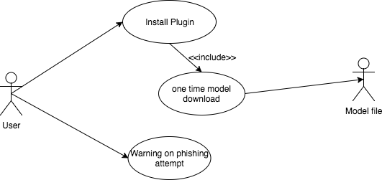
SYSTEM MODELS
Use Case Diagram
The overall use case diagram of the entire system is shown in fig- ure The user can install the plugin and then can continue his normal browsing behaviour. This plugin will automatically check the browsing pages for phishing and warns the user of the same.
Pre condition: The user visits a website and have plugin installed.
Post condition: The user is warned incase it’s a phishing website.

Slide 7
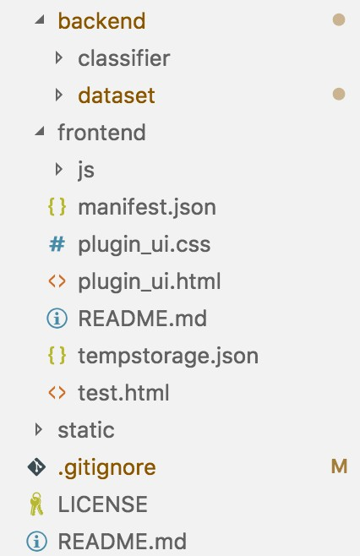
SYSTEM DEVELOPMENT
The system is overall split into backend and plugin. The backend consists of dataset preprocessing and training modules. The frontend which is the plugin consists of javascript files for content script and background script including the Random Forest script. The plugin also consists of HTML and CSS files for the user interface
Technology and Tools Used
Random Forest Classifier: A machine learning algorithm employed to accurately classify URLs as either phishing or legitimate based on a set of features.
Python: The primary programming language used for developing the classification model and data preprocessing.
JavaScript: Utilized for developing the Chrome extension, allowing real-time analysis of URLs while browsing.
Chrome Extension API: The framework used to build the extension, enabling integration with the Chrome browser and access to necessary web resources.
Scikit-learn: A Python library used for implementing the Random Forest Classifier and other machine learning functionalities.
NumPy: A library for numerical computations in Python, facilitating data manipulation and analysis.

Slide 8
PROTOTYPE ACROSS THE MODULES
The input and output to each module of the system is described in this section.
• Preprocessing: This module takes the downloaded dataset in arff
format and the creates four new files listed as training features, training class labels, testing features, testing class labels.
• Training: This module takes the four output files from pre-
processor and gives a trained Random Forest object along with the cross validation score on the training set.
• Exporting model: This module takes the learned Random Forest
classifier object and the recursively generates its JSON represen- tation which is written to file in disk.
• Plugin Feature Extraction: This module takes a webpage as in-
put and generates a feature vector with 17 encoded features.
• Classification: This module takes the feature vector from feature extraction module and the JSON format from the Exporting mod- el module and then gives a boolean output which denotes whether the webpage is legitimate or phishing

Slide 9
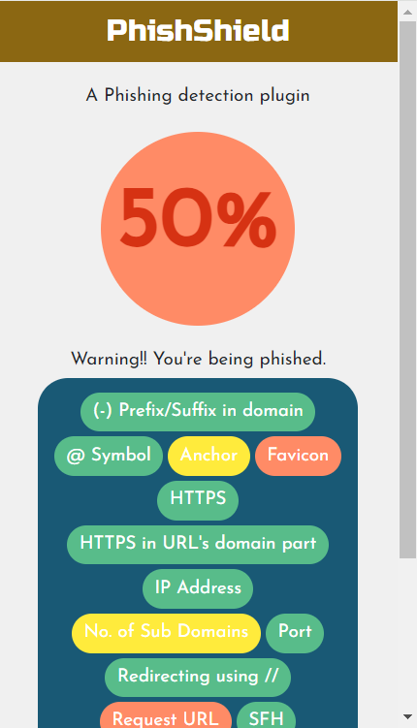
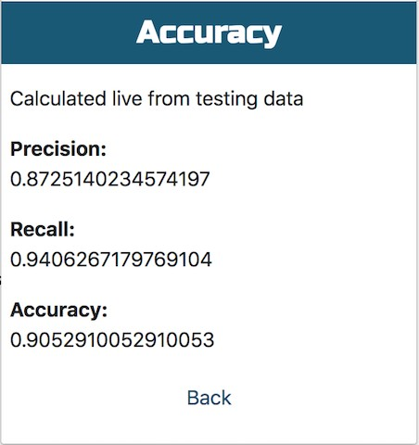
Working Model
The output of the plugin while visiting a phishing site taken from PhishTank. This site has a low trust value and also the light red circle in- dicates phishing.
The precision, recall and F1 score of the phishing classifier is cal- culated manually using javascript on the test data set. The results are shown in the figure

Slide 10
CONCLUSION
In conclusion, our project aims to tackle the significant threat posed by phishing attacks through the development of an innovative Chrome extension. By leveraging real-time URL analysis and client-side processing, we provide users with a powerful tool to detect and avoid phishing websites while safeguarding their privacy.
This extension not only enhances user security but also empowers individuals to navigate the web with confidence. As phishing techniques continue to evolve, our solution remains adaptable through continuous learning, ensuring that users are always protected against the latest threats.
Ultimately, this project represents a meaningful step towards creating a safer online experience for all users.

Slide 11
THANK YOU

